Slide 1
Optimal Deployment of Electric Vehicles & charging Stations
CASE STUDY
- Aditya Arya

Slide 2
INTRODUCTION
In terms of environment-friendly traffic tools, the electric vehicle has vast potential. Moreover, the construction of the charging and battery swap stations is critical for popularizing it. However, despite construction in some cities, the deployment of charging stations is still far from mature. Therefore, to promote EV adoption, we provide a brief case study proposing some solutions.

Slide 3
METRICS
Load on charging station
Load on power station due to EV.
Travel Cost
Drivers' travel cost from the charging station to their travel destination
Existing charging stations
Investment for charging location

Slide 4
Explanation
Load on charging station
As number of EV’s is rapidly increasing , so is the demand of power required to charge them. In comparison, most EV owners have access to home charging, whereas those living in apartments or condos have difficulty charging their vehicles at home. Therefore, expanding the charging network is necessary to push EV sales to the next level.
Travel Cost
Charging stations should be easily accessible to consumers, so we must minimize travel costs to charge as much as possible.

Slide 5
Explanation
Existing charging stations
It is important that the location of the new charging station does not overlap with that of existing charging station.
Investment for charging location
An analysis of the location of the charging station must be completed to minimize investments resulting from high land prices or any other issue.

Slide 6
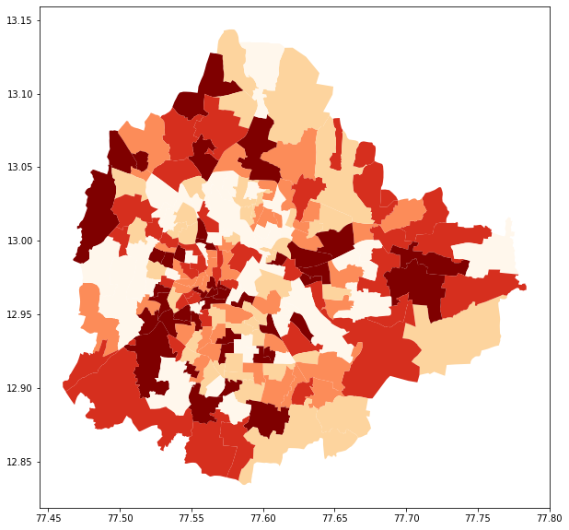
Demand for charging in Bangalore based on popularity

Slide 7

Proposed Algorithm
neighbour_point = $\sum{ } {αp}_{j + }{βq}_{j}{ + γr}_{j}{ + δs}_{j}$
final_point = min $\sum{ } f_{j}y_{j}+ neighbour_point$
$f_{j}=$ fixed cost of charging station at location $j$, $y_{j}$ indicates whether to build a charging station at location $j$, $p_{j}$ is the number of food court nearby at location $j$, $q_{j}$ is the number of gas station at location $j$, $r_{j}$ is the number of malls at location $j$, $s_{j}$ is number of apartments at location $j$.
$$α,β,γ,δ can be configured to increase the weightage of neighbouring point$$

Slide 8

Distance Formula
Haversine Formula
Haversine formula computes distance between two points on the surface of a sphere using the latitude and longitude of the two points.
$a=\sin^{2}⁡(Δlat/2)+cos⁡($ lat1 $)⋅\cos\left(lat2\right)⋅\sin^{2}\left(\frac{Δlon2}{2}\right)$
$$c=2⋅atan⁡2(Va,V(1−a)) \\ d=R⋅c$$
d is distance between two points in km

Slide 9
Setting up the Optimization Problem
Decision: choose a subset from currently existing parking lots as candidates
to install chargers
Objective: Minimizing the cost of installing charging stations
+ number of popular places nearby like school, Malls etc
Constraints:
1.All the charging demand are satisfied.
2.Charging capacity does not exceed each station’s limit.

Slide 10
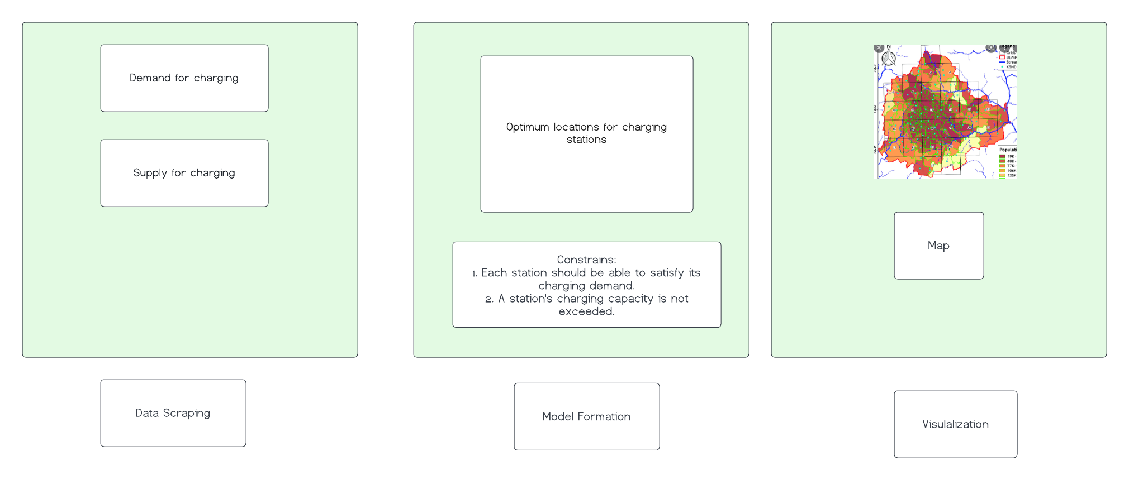
Architecture

Slide 11
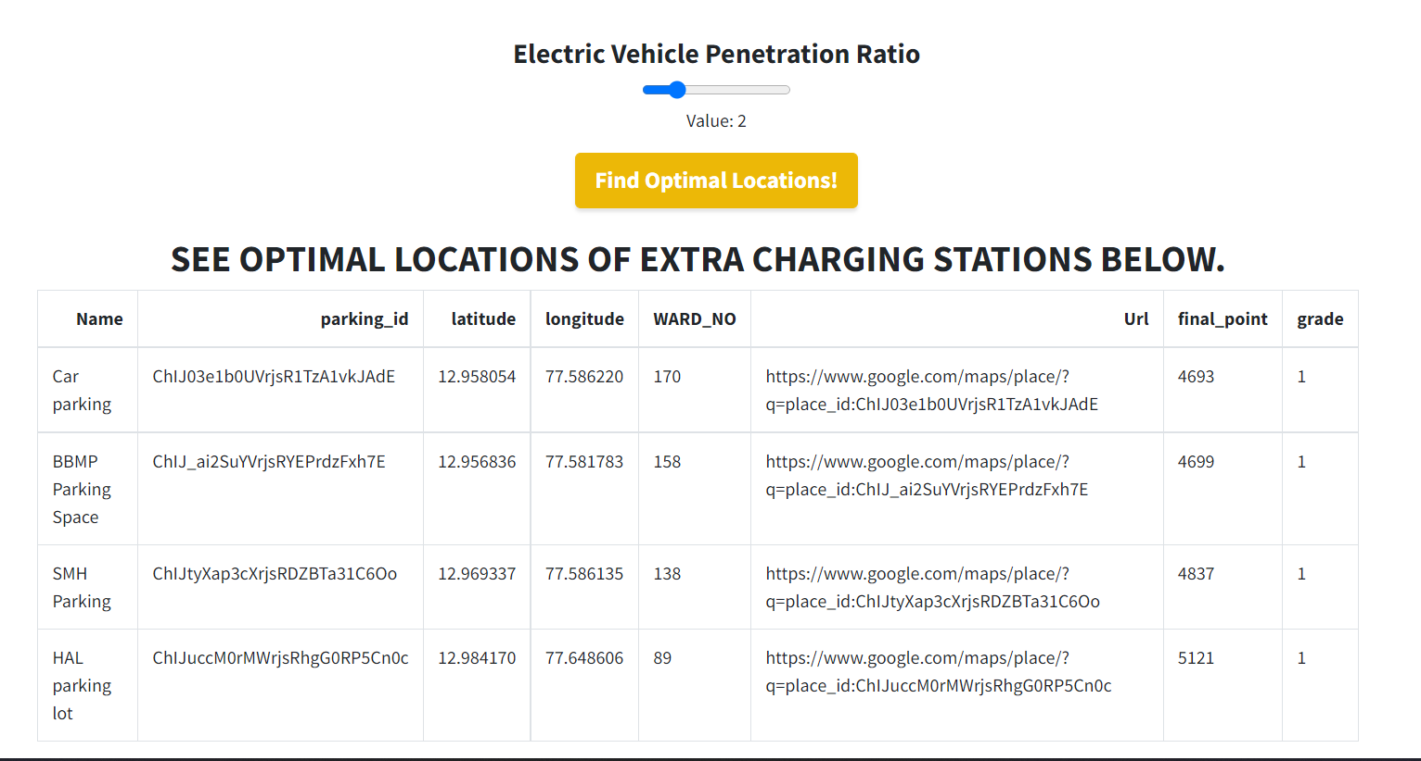
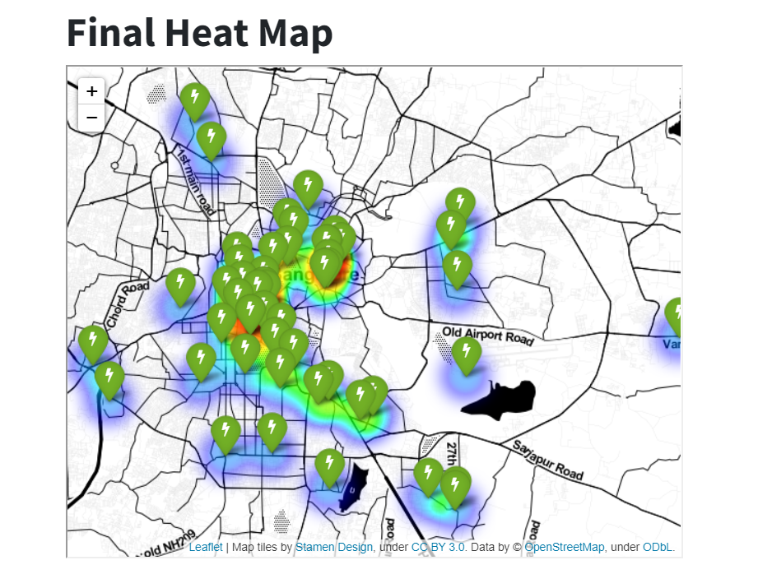
Result

Slide 12
REVIEW OF SYSTEMS
WEB APP
Model
To display result in form of pointers on the map.
Based on the data and algorithm , recommend charging stations.
Web scraping
Scarping all existing charging station.
Gather data of trips done in the city.

Slide 13
Web scraping
Scarping data of population density , locations of food court ,gas station, grocery shops, parking locations, restaurant, malls, university.
Gather data of trips done in the city.
Model
Based on the data and algorithm , recommend charging stations.
Minimizing the cost of installing charging stations
Constraints:
Each station should be able to satisfy its charging demand.
2. A station's charging capacity is not exceeded.

Slide 14
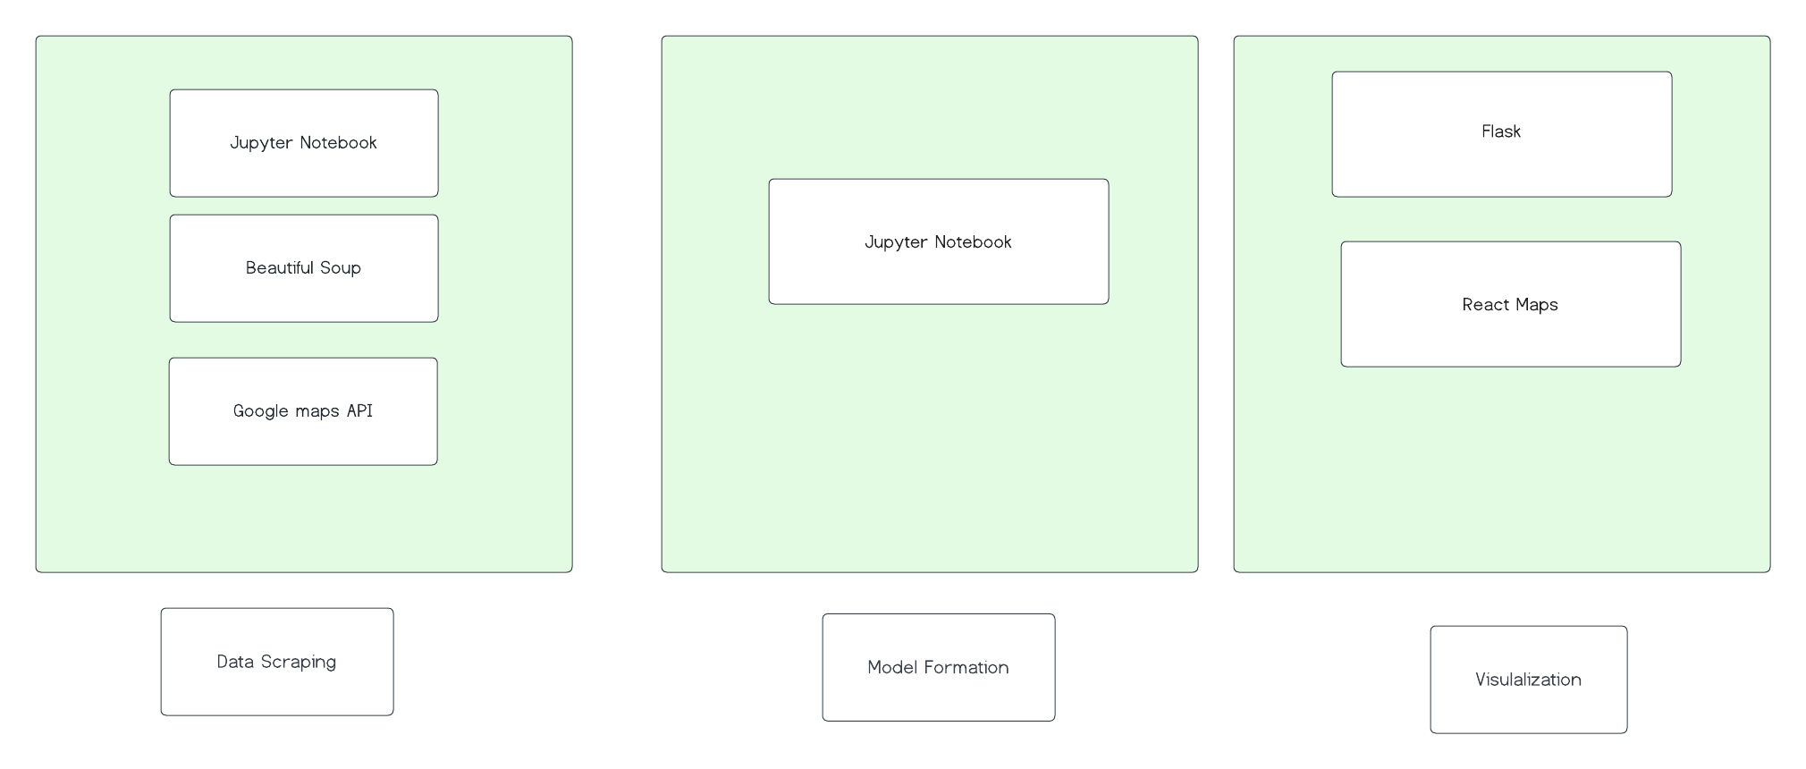
Tech Stacks

Slide 15
THANKS!

Slide 16
References:
https://www.mckinsey.com/industries/automotive-and-assembly/our-insights/the-potential-impact-of-electric-vehicles-on-global-energy-systems
https://www.streetlightdata.com/electric-vehicle-ev-charging-station-deployment-data/
https://www.ionenergy.co/resources/blogs/accelerating-ev-growth-india/#:~:text=EV%20sales%20in%20India%20(excluding,the%20past%20year%20is%20encouraging.

